Slide 1
Location recommendation for a new vegetarian restaurant in San Francisco, California Nov. 2020

Slide 2
1 Business Problem and Background
Restaurants are one of the most important business in the world. The main factor of having a restaurant business successful is the location of the business. It is more likely to fail if your business is very close to the old strong competitors. The business plan is to open a new vegetarian restaurant in the City of San Francisco, California and the following are the very important questions to be answered properly before starting the business:
The locations of vegetarian restaurants in san Francisco.
Comparing vegetarian places to the total number of restaurants.
Where is the densest area for restaurants?
Where is the densest neighborhood for vegetarian restaurants?
What is the rating of the Vegetarian restaurants?
What is the percentages of vegetarian population in the area? (if possible)

Slide 3
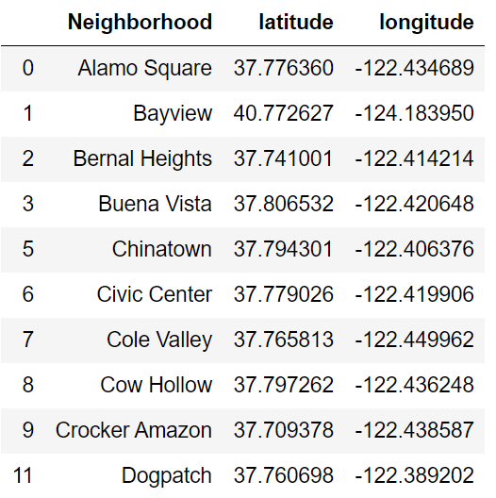
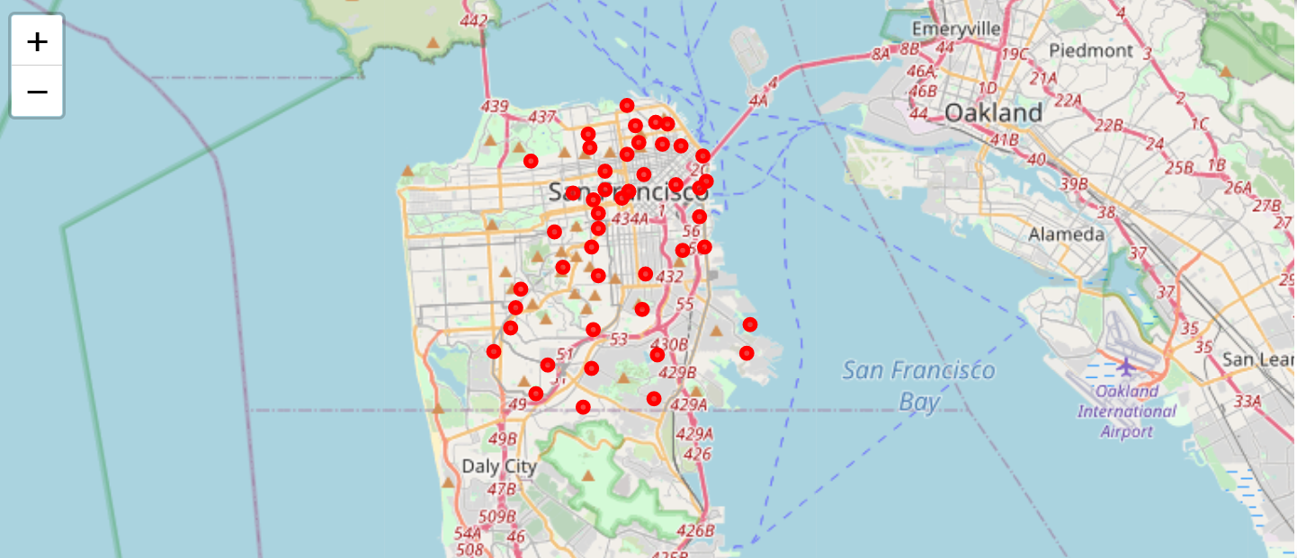
2 Data Source and Description
San Francisco 51 neighborhood data: https://localwiki.org/sf/Neighborhoods
Location data: www.foursquare.com API
Geographical Coordinates: geopy python library

Slide 4
3 Methodology
The following tasks need to be performed:
Find the neighborhoods
Obtain the geographical coordinates
Get location data from foursquare API
Clean the data and create data frame
Explore the neighborhoods
Identify the number of all types of restaurants locations
Identify the number of vegetarian restaurants locations
Analyze each neighborhood per restaurants
Make a data frame for vegetarian restaurant
Group by neighborhood and restaurant types
Clustering Neighborhoods using K-means clustering per resturants
Visualization

Slide 5
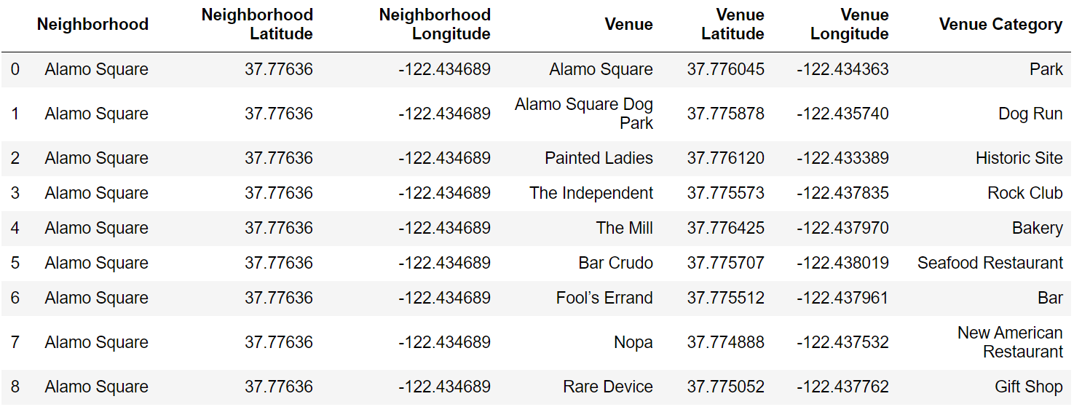
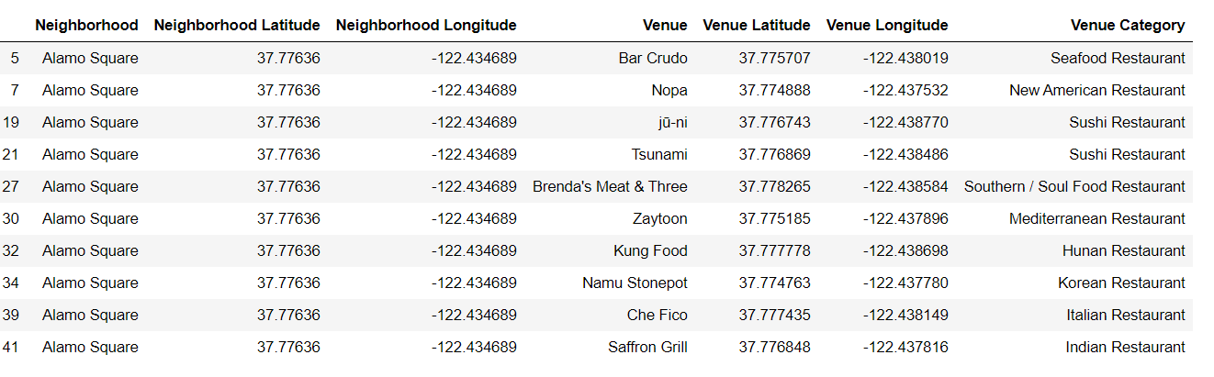
4 Exploring the neighborhoods
Data set for all venues in SF neighbors
All type of Restaurants in SF neighborhoods

Slide 6
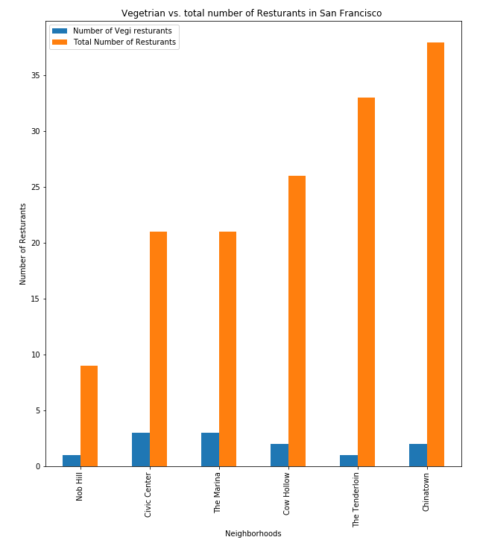
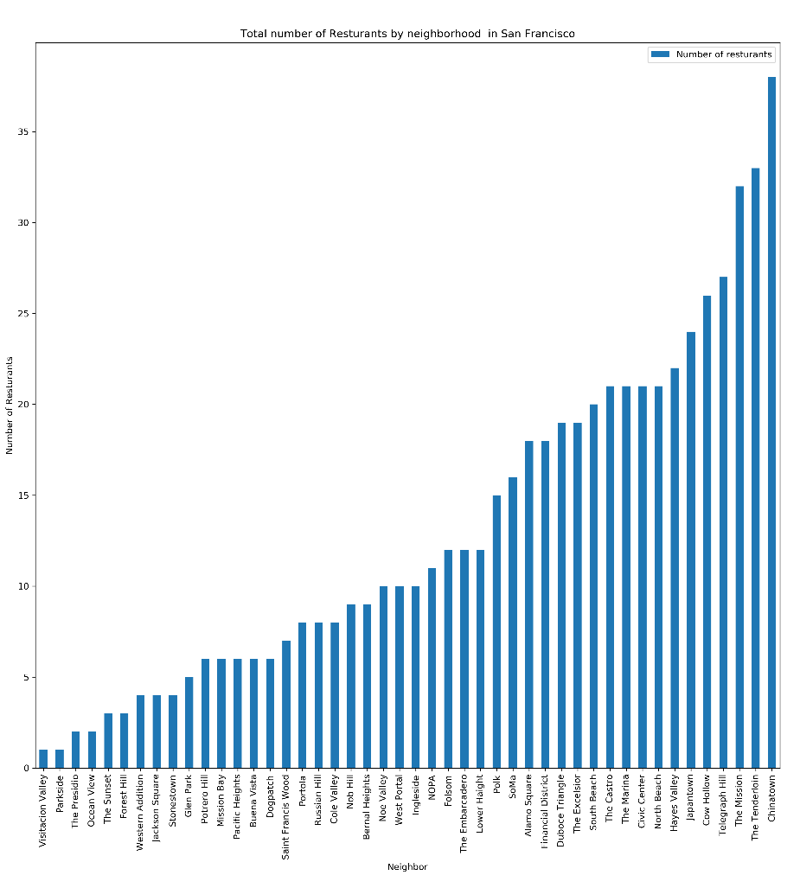
Vegetarian VS Total number of restaurants
Number of Vegetarian restaurants in SF Neighborhoods
Number of restaurants in each Neighborhood

Slide 7
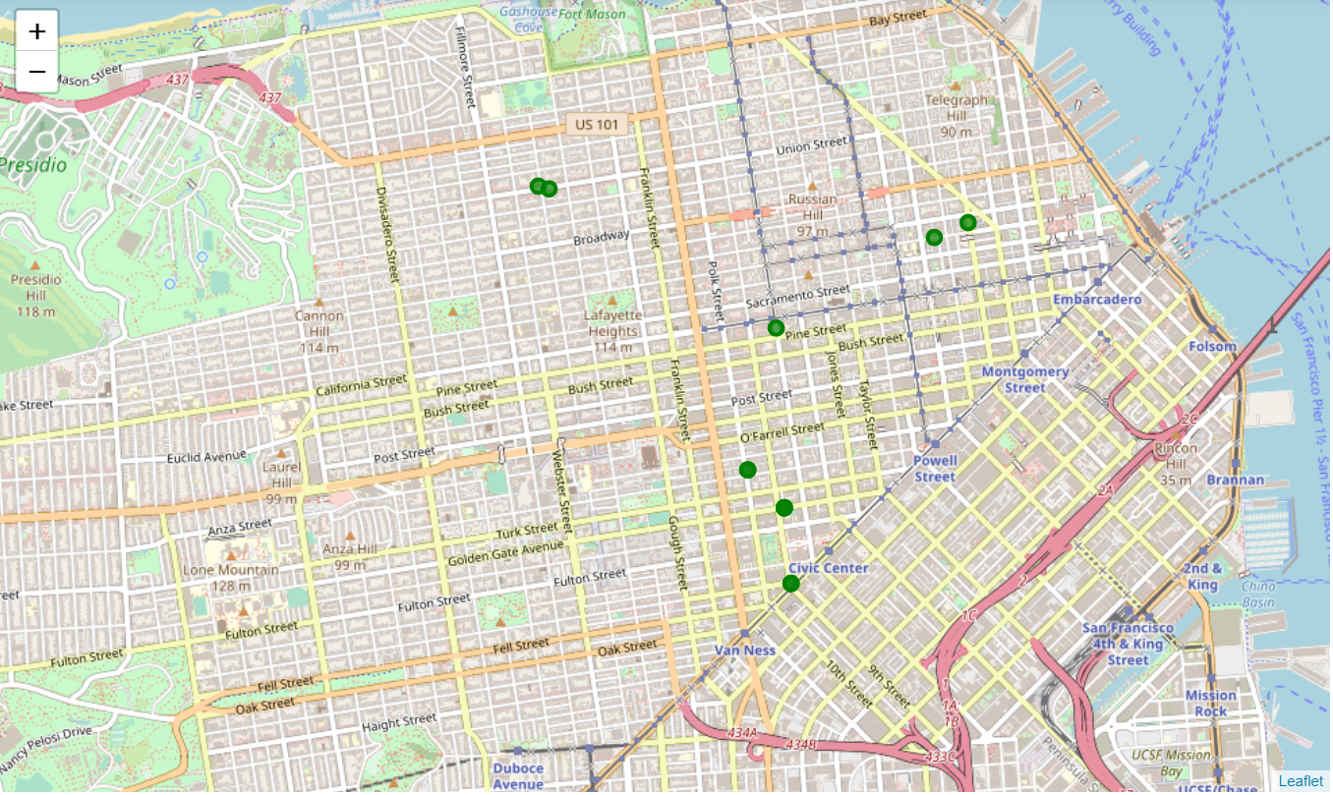
vegetarian restaurant locations

Slide 8
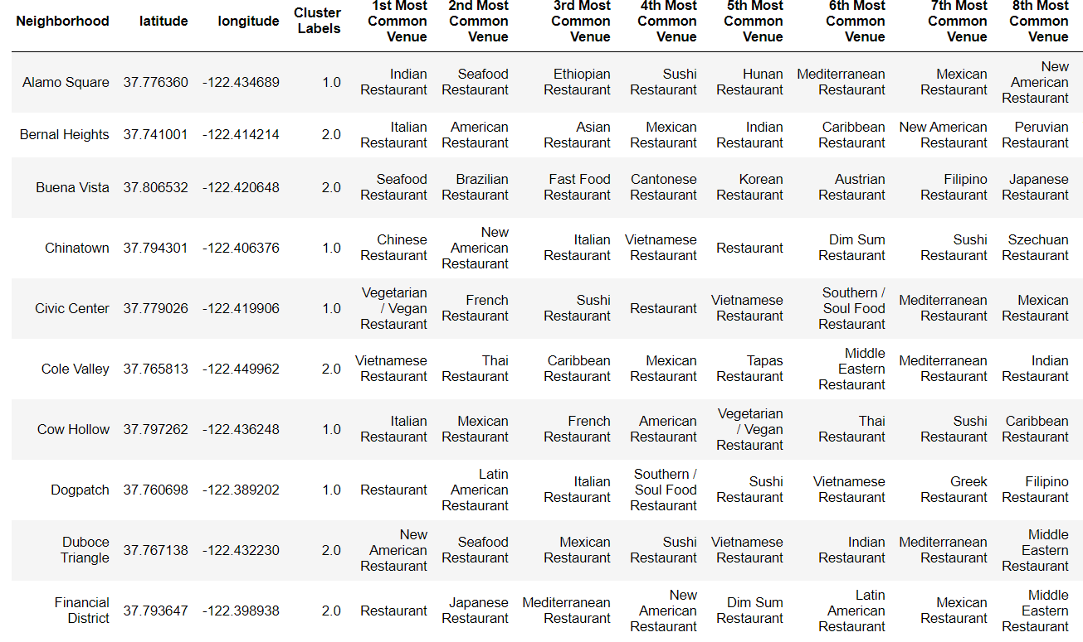
5 Neighborhood clustering: K-Mean (K=5)
Most common restaurants and identified clustering per neighborhood data frame

Slide 9
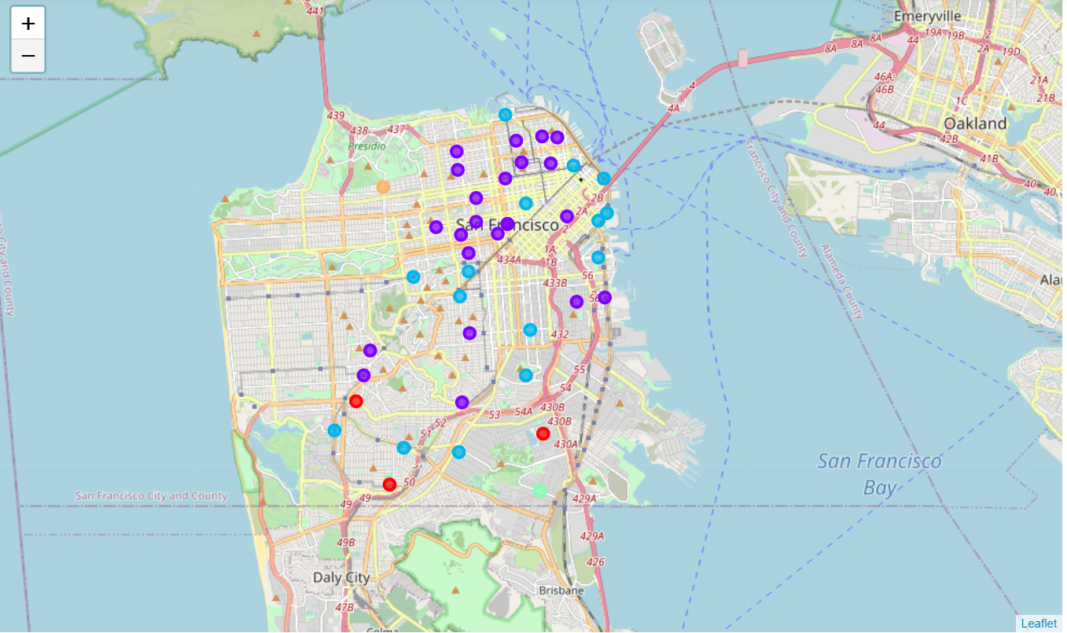
Clusters location on map
Class of clusters location on map (similar colors represent similar clusters)

Slide 10
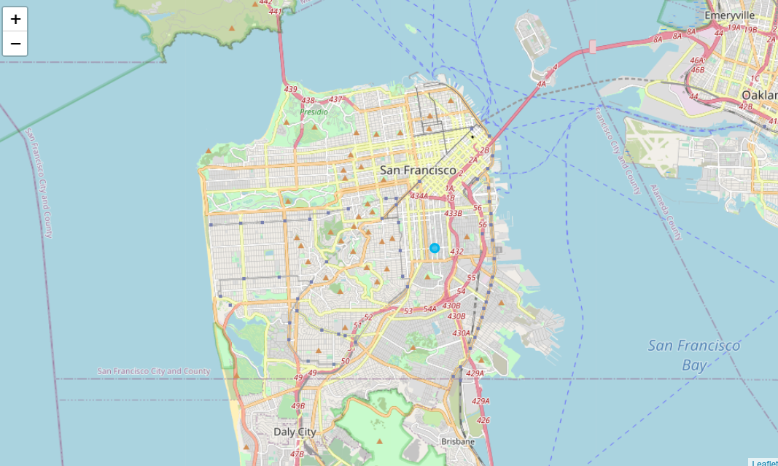
6 Results and Discussion
Only 7 neighborhoods have vegetarian restaurants available.
Opening a new vegetarian restaurant, at the neighborhood that has many restaurants types except vegetarian is recommended.
“The Mission” neighborhood is recommended to open a Vegetarian restaurant.
There are more factors to consider to get better recommendations, however, it is out of scope of this article.

Slide 11
7 Conclusion
For a businessman, the most important factor is choosing a right place to start the business. This is more crucial for restaurant business. This article tries to recommend a good location at the city of San Francisco, California for a vegetarian eating place.
After analyzing all the neighborhoods and exploring the available restaurant and, in specific, vegetarian / vegan eating places, the ‘The Mission’ neighborhood is recommended for opening new restaurant for vegetarians. Based on location data analyses, this neighborhood is the dense area of eating places, where, however, there is no single vegetarian restaurant in this region. Therefore, makes it a perfect place for opening a new restaurant for vegetarians. The neighborhoods are also classified based on the frequency of restaurants available in the area using K-Means clustering methodology. This could be used for further analyses which is out of this articles scope.

Slide 12
8 Future works
This project could be well extended for many other types of business and sectors. There are a few tides that can be taken into exploration:
1. Where to open a fast-food restaurant
2. Where to open coffee shop
3. Where a police station might be needed to open
4. To spot the locations with higher crime rates
Jupyter notebook (.ipynb format):
https://github.com/yasser64b/Coursera_Capstone/blob/master/Coursera%20Capstone%20Project_Final.ipynb

